Slide 1
The Acts of the Apostles
Acts 23 – Paul’s Second Defense in Jerusalem (Before the Sanhedrin Council)
Sunday – May 26, 2019

Slide 2
Paul’s Defense
The second of five defenses after Paul’s third tour:
First – Acts 22 – On the steps of the Temple court.
Second – Acts 23 – Before the Sanhedrin Council.
Third – Acts 24 – Before Felix.
Fourth – Acts 25 – Before Festus.
Fifth – Acts 26 – Before Agrippa

Slide 3
Paul’s Defense
The second of five defenses after Paul’s third tour:
Paul is brought before the Sanhedrin Council for questioning.
The Sanhedrin Council was the supreme Jewish court of justice. The council’s power was not limited to religious affairs but to civil as well. The Roman government seemed to be indifferent to its existence.
The council was composed of 71 members who sat in a half circle pattern.
The members: High priest as head or president. Members were known as chief priest, elders and scribes.

Slide 4
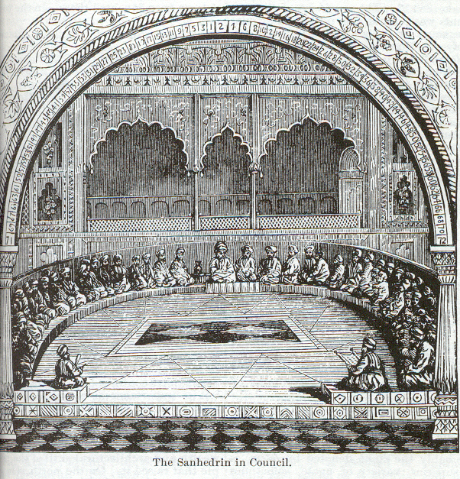
Paul’s Defense
The second of five defenses after Paul’s third tour:
Smith’s Bible Dictionary

Slide 5
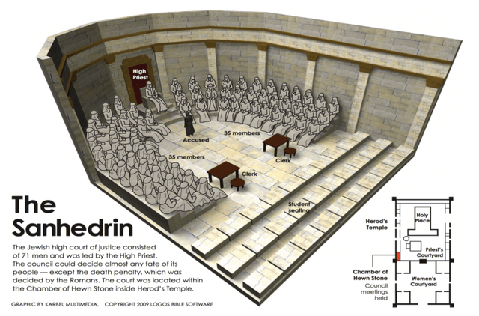

Slide 6
Paul’s Defense
The Sadducees: “Essentially aristocrats.” An aristocrat, (noble heritage).
The Sadducees denied the resurrection of the dead (Matthew 22:23ff; Acts 4:12; 23:8).
“Consequently they denied future rewards and punishments in a life to come.”
The Sadducees denied the existence of angels and spirits as well.
“The consequent emphasis on life in this world was consistent with the Sadducees’ concern with their position of power, status, and wealth, and it left no room for messianic hopes and a coming kingdom of God.” Source: ISBE

Slide 7
Paul’s Defense
The Pharisees: “A Jewish sect or party whose members voluntarily took upon themselves a strict regimen of laws pertaining to purity, Sabbath observance, prayer, and tithing … The Pharisees and scribes observed and perpetuated an oral tradition of laws handed down from the former teachers and wise men of Israel. This oral law, or Halakah, was highly venerated by the Pharisees and scribes. They taught that it had been handed down from Moses and was to be given the same respect as the written laws of the Pentateuch.”
The Pharisees did not pursue wealth. They believed in the resurrection of the body, that God controls events and that evil people will suffer punishment in the afterlife. Source: ISBE

Slide 8
Paul’s Defense
Paul looked “stedfastly on the council” (23:1)
The word “stedfastly” means to “fix the eyes on, gaze upon” (Thayer 83).
Paul’s situation demanded his utmost attention and observation of the council.
Paul states, “I have lived before God in all good conscience until this day” (23:1b).

Slide 9
Paul’s Defense
Discuss the importance of conscience: (cf. 1 Corinthians 8, 10)
The conscience is our mind in action. It prompts us to do the things we know to be right and refrain from the things known to be wrong.
Paul’s conscience was not bothered by his prior treatment of Christians because he thought he was doing right (cf. Acts 26:9-11).
Ananias, the high priest, commanded that Paul be struck after this statement.
It may have been that Ananias felt Paul to be a vile man who rejected Moses and the Law. Such a statement from a man who rejected Moses then would have repulsed Ananias.

Slide 10
Paul’s Defense
Acts 23:3, “Then said Paul unto him, God shall smite thee, thou whited wall: and sittest thou to judge me according to the law, and commandest me to be smitten contrary to the law?”
“Jews were accustomed to whitewash the entrances to their sepulchers, as a warning against defilement by touching them; is applied to a hypocrite who conceals his malice under an outward assumption of piety.” (Thayer).
To be struck before a just trial is given is to violate the Mosaic Law. (Leviticus 19:15)
Ananias sits to judge Paul by the Law yet violates it himself.

Slide 11
Paul’s Defense
Others who were near by revealed to Paul that Ananias was the high priest and he should be careful as to how he talks to him (23:4).
Paul’s reply was that he did not know that Ananias was high priest. Why?
Paul knew well the Mosaic Law on treatment of the high priest. Paul quotes from Exodus 22:28 which states, “thou shalt not speak evil of a ruler of thy people.”

Slide 12
Paul’s Defense
No one really knows why Paul is being questioned.
The accusations against him in chapter 21
He was teaching men to forsake the Mosaic Law, not to circumcise their children (21:21).
He is falsely accused of bringing a Gentile (Trophimus) into the temple (21:28-29).

Slide 13
Paul’s Defense
Paul knew that the members were divided.
Paul states that he is a Pharisees who believes in the resurrection of the dead and this is the reason he is standing before them in the council.
The Pharisees in the council would have now sided with Paul while the Sadducees, who do not believe in any type of resurrection, were opposed to him.
Consequently, the two groups “clamored” with each other over the guilt of Paul.
The chief captain once again saves Paul. He commands his soldiers to bring him back to the castle. cf. Romans 15:30-31

Slide 14
Paul’s Defense
Paul knew that the members were divided.
The resurrection of Christ and the general resurrection of the dead are inseparably linked. John 5:28-29; Acts 17:30-31.
Paul preached the resurrection. Acts 24:21; 1 Corinthians 15:13-14
This fact stirred the Sadducees from the beginning. Acts 2,3; 4:1-2
The chief captain once again saves Paul. He commands his soldiers to bring him back to the castle. cf. Romans 15:30-31

